Slide 1
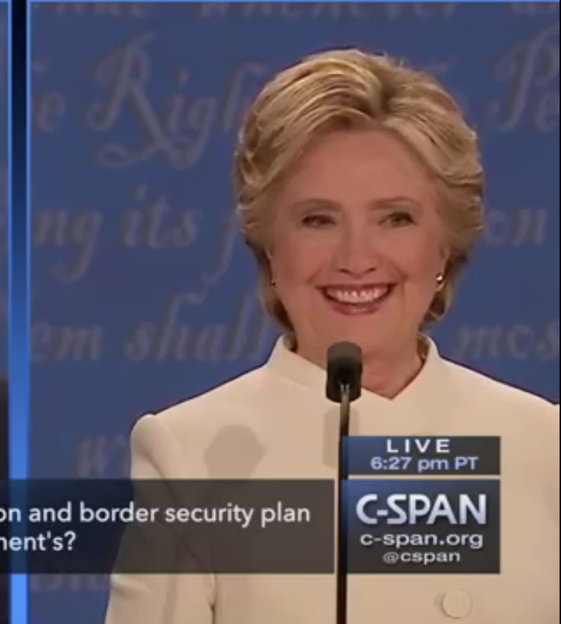
Neutral: 10%
Happy: 80%
Sad: 10%
Surprise: 40%
Fear: 10%
Disgust: 5%
Anger: 4%
Contempt: 20%

